Slide 1
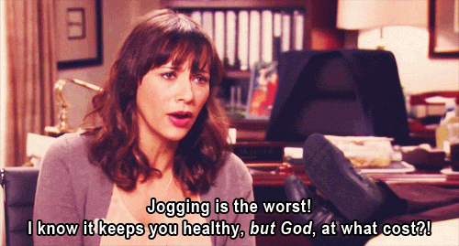
The Fitness Social V 2.0
A social network for those who save their money to go to the movies and still refuse to jog (so most of us)

Slide 2

Part I A Bit Of Context
Where I am very good at pointing out real life problems but quite bad at doing anything about them

Slide 3
This is about fitness
Current Online Sharing System: selfies via niches inside popular networks (#fit, #workout) – Blogging & following system
Current IRL Sharing System: Communal gyms & outdoors groups
Challenge: create linking instead of following – support exchange & actual sharing
Too many platforms &/or innapropriate (see comptetitors)

Slide 4
Goal
Make it horizontal instead of vertical

Slide 5

Part II A Bit Of Research
Where I know I have competitors, but i also know why I’ll be better than them

Slide 6
What, why and who for
a social network for people who want to work out but are not already gym addict/do not have an iron will.
16-30 + , middle class (no money to spare on a private instructor)
Lack of proper support & sharing space for people working out and not taking themselves seriously
“The gym? No thanks, everyone’s crazy there” – Elisa, 21, not a gym addict, kinda would like to work out from time to time
“I tried to do some ab work before going to bed, i held on for two weeks, then I missed one night and I was done” – Pauline, 22, doesn’t really work out but is still interested in this kinda things

Slide 7
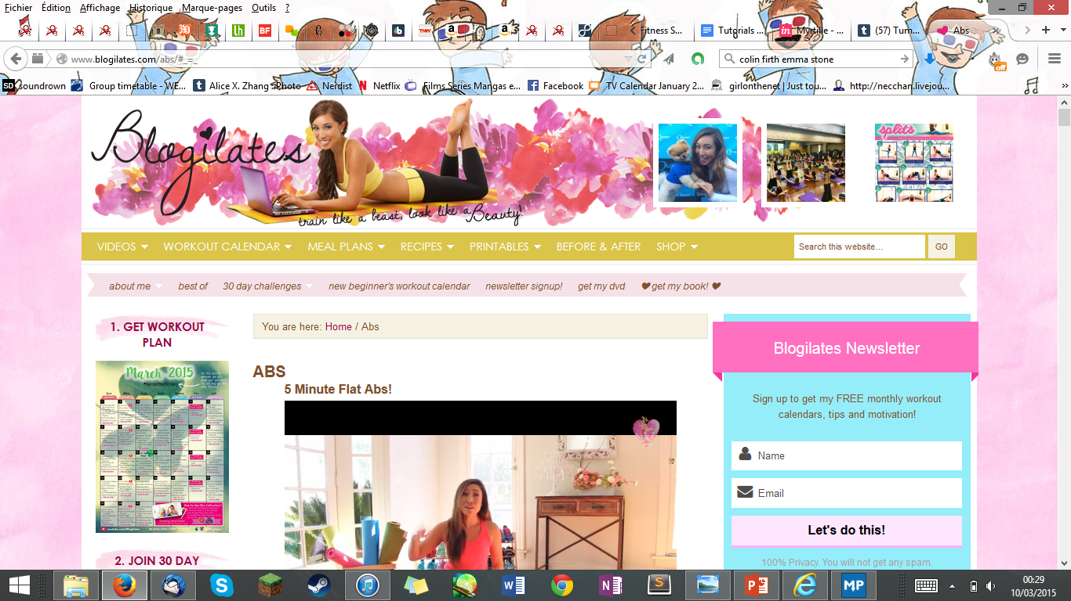
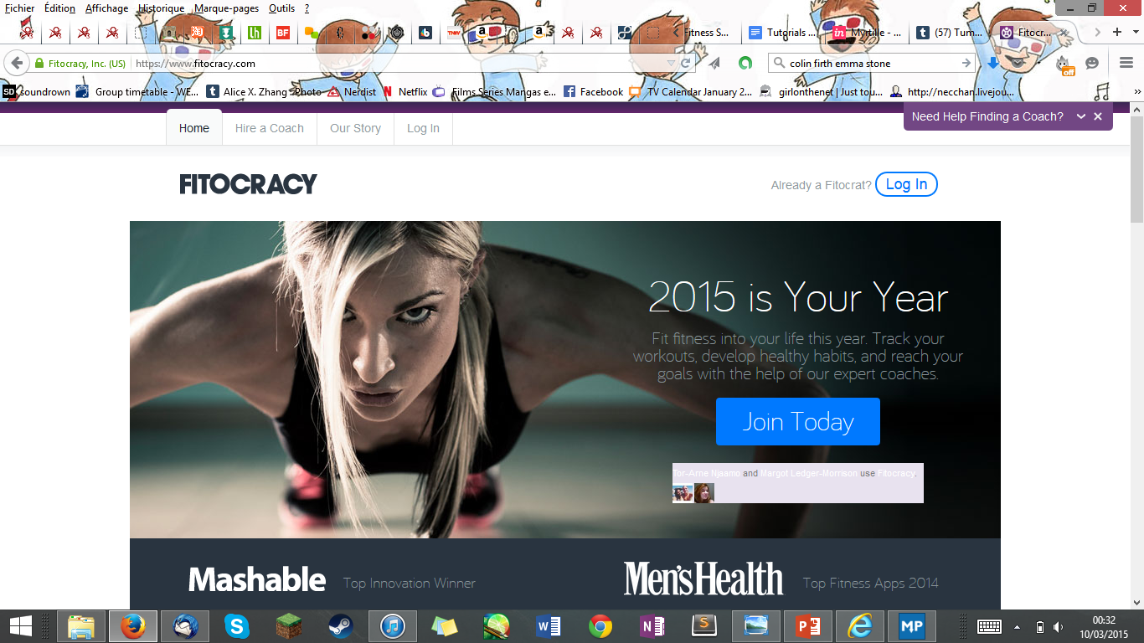
Competitor analysis: Blogilates & Fitocracy
Nice & aiming at same target, although very girly
Blog – follow only 1 person, no actual community
You can post & blog about it, but in the same way you would follow a famous diet
For gym fanatics
Very confusing if not already experienced in the topic
Freemium, pay to follow a plan made by other users
scary

Slide 8
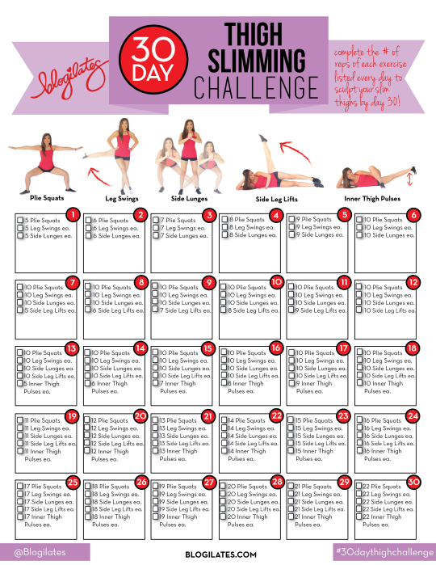
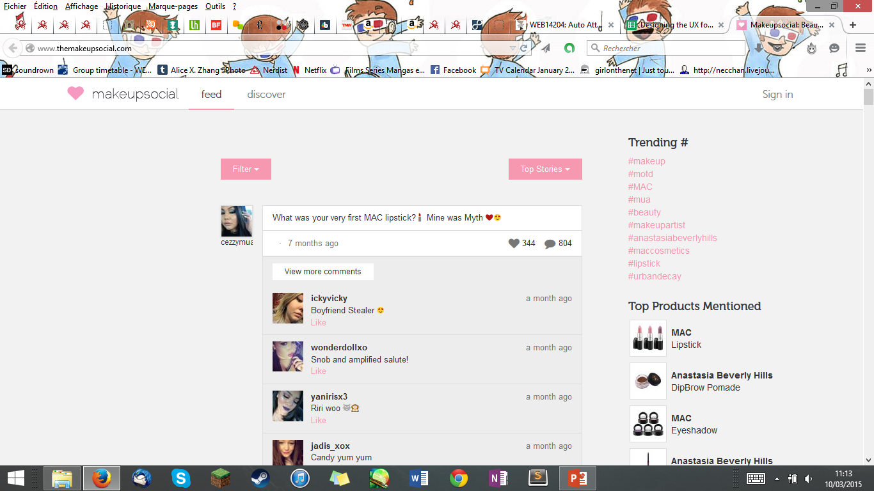
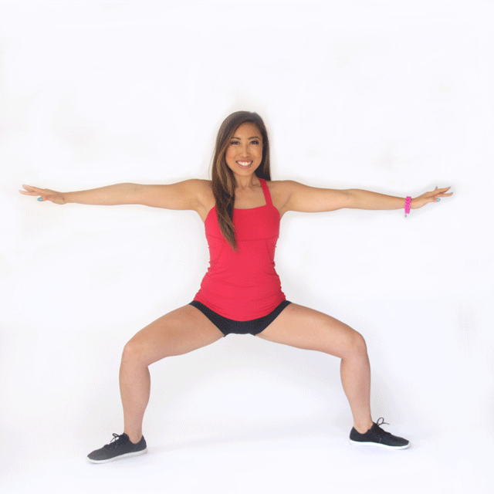
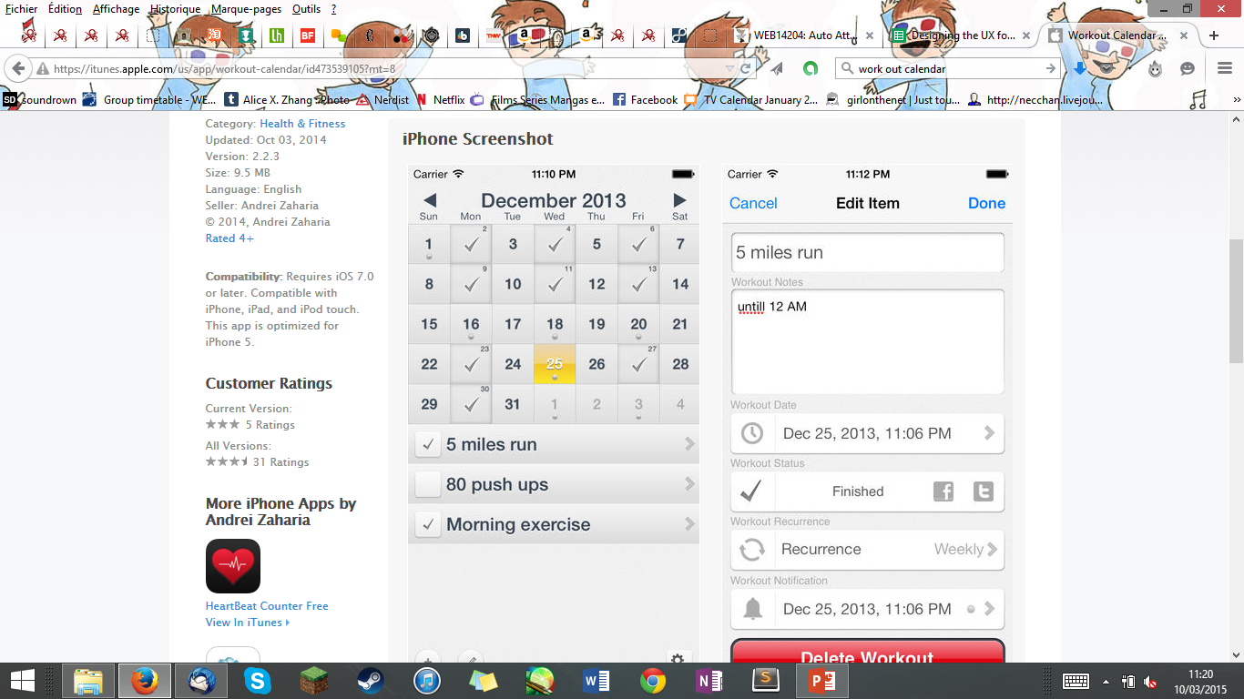
Inspirations

Slide 9

The fitness social is the perfect mix between scary gym warriors networks & fitness blog communities
Fun
Guidance throughout registering & after
No freemium
Not scary
You’re not alone anymore

Slide 10
Character study : meet meghan
20’s, average size, broke student
Would like to work out, but lacks both motivation & knowledge
Meghan has 3 options

Slide 11

Option 1
She tries to ask her friend chloe to be her
work out buddy
But they only know how to badly do squats

Slide 12

Chloe gives up after a week because she’s having an affair with Samantha
Meghan is alone again
Chloe’s a bitch

Slide 13
Option 2
Meghan tries to train by herself
She looks up videos on youtube
But there are too many!!!

Slide 14

Meghan is lost and getting fat

Slide 15

Option 3
Meghan uses her brain and asks her very smart friend (let’s call her Margot) for advice
And boy does she get good advice

Slide 16

Thanks The Fitness Social, Meghan is happy!
She manages to maintain a regular work out schedule and feels supported!
She can eat as much cake as she wants
Without feeling guilty because of the societal norms forced upon her!!

Slide 17

Part III A Bit Of Wireframes
Or the study of a struggle

Slide 18
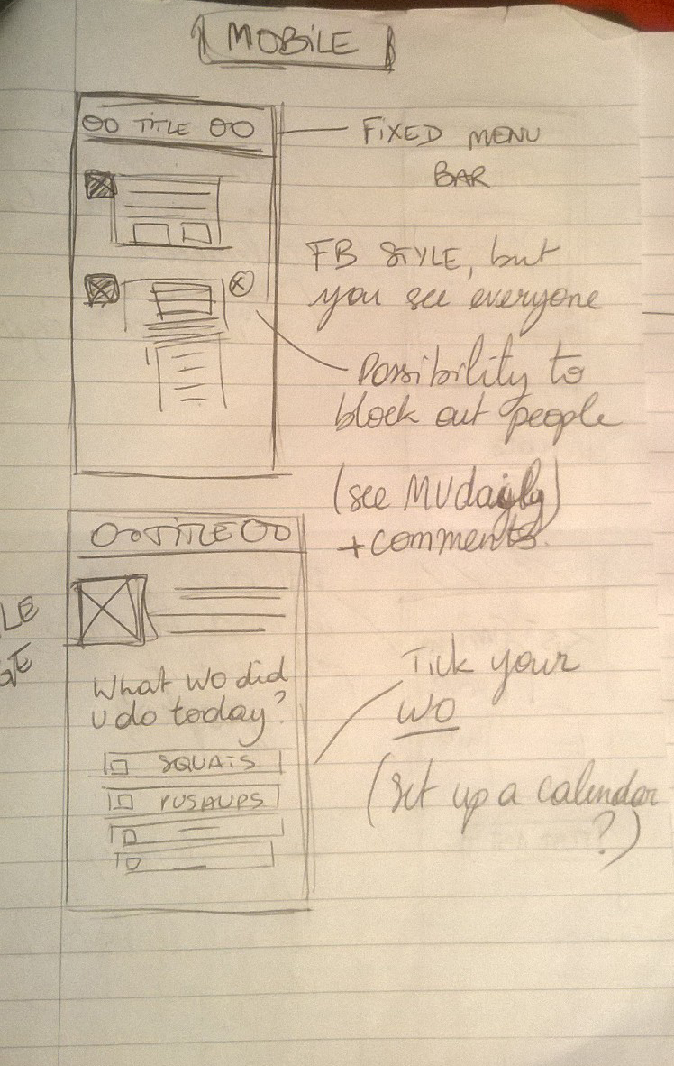
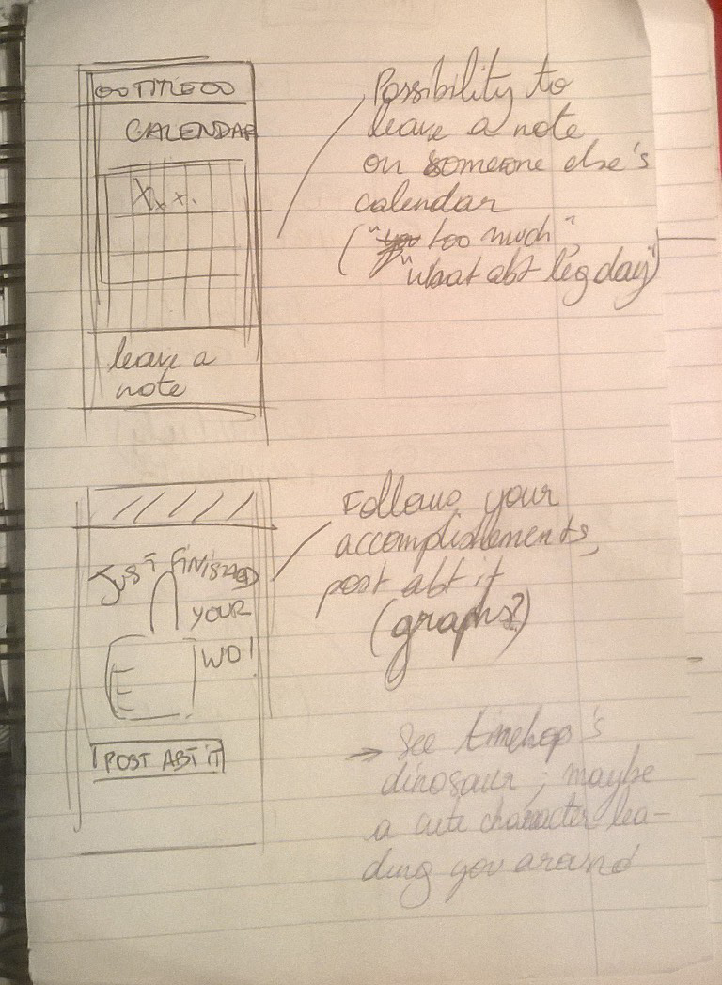
Evolution of Wireframes

Slide 19
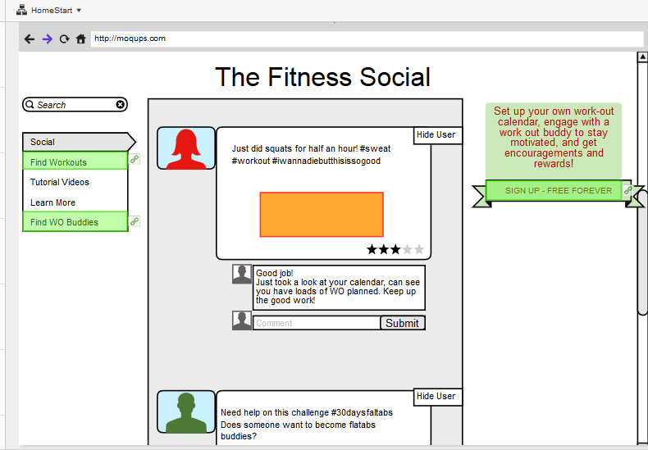
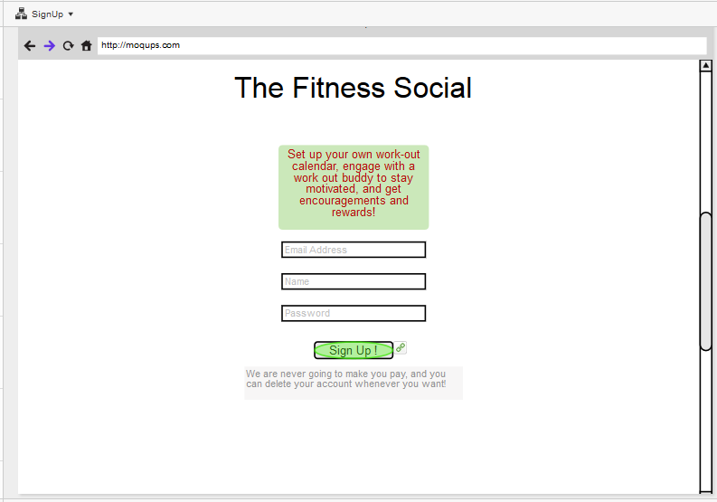
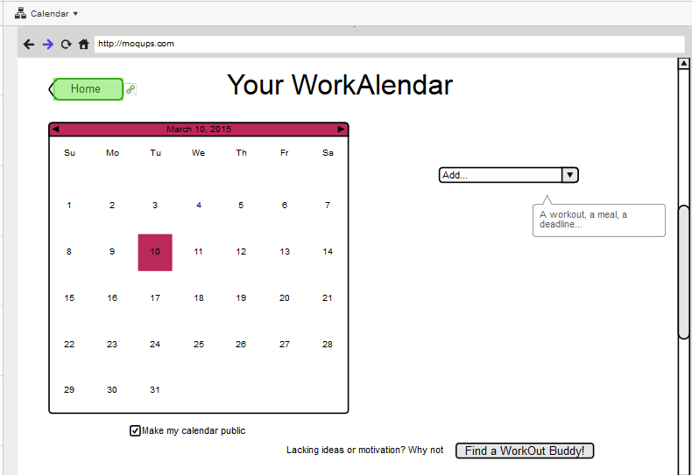

Slide 20
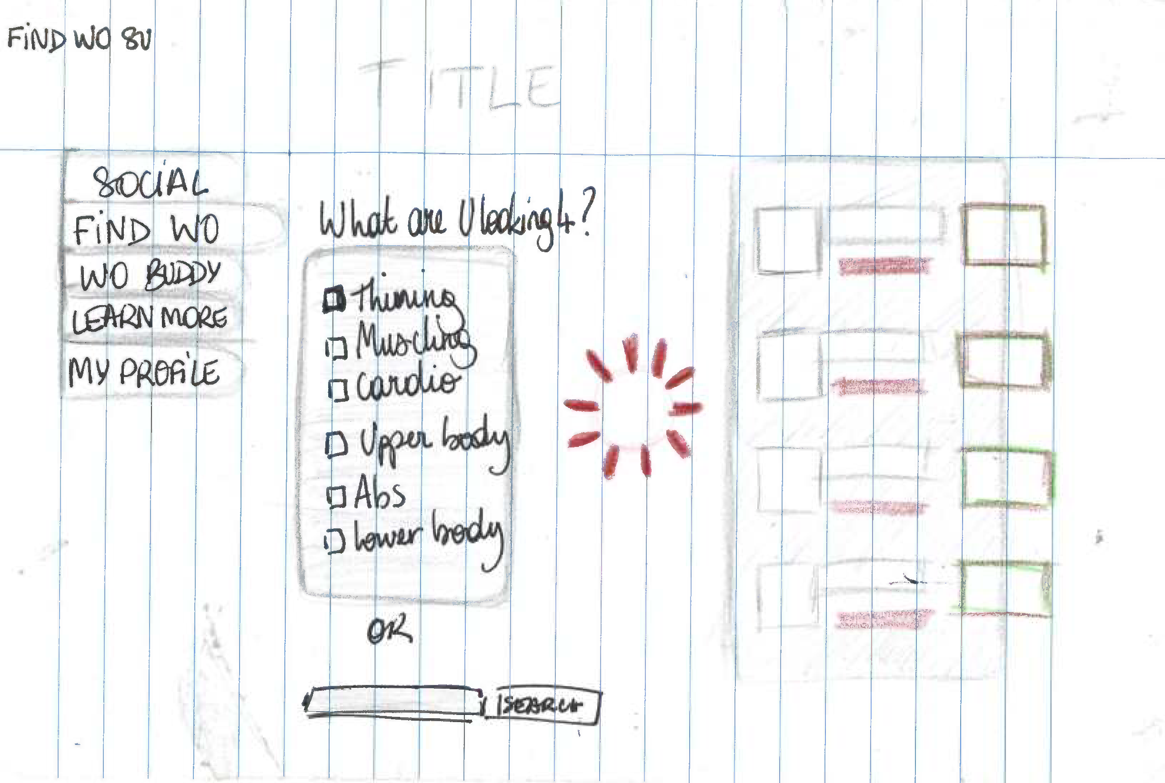
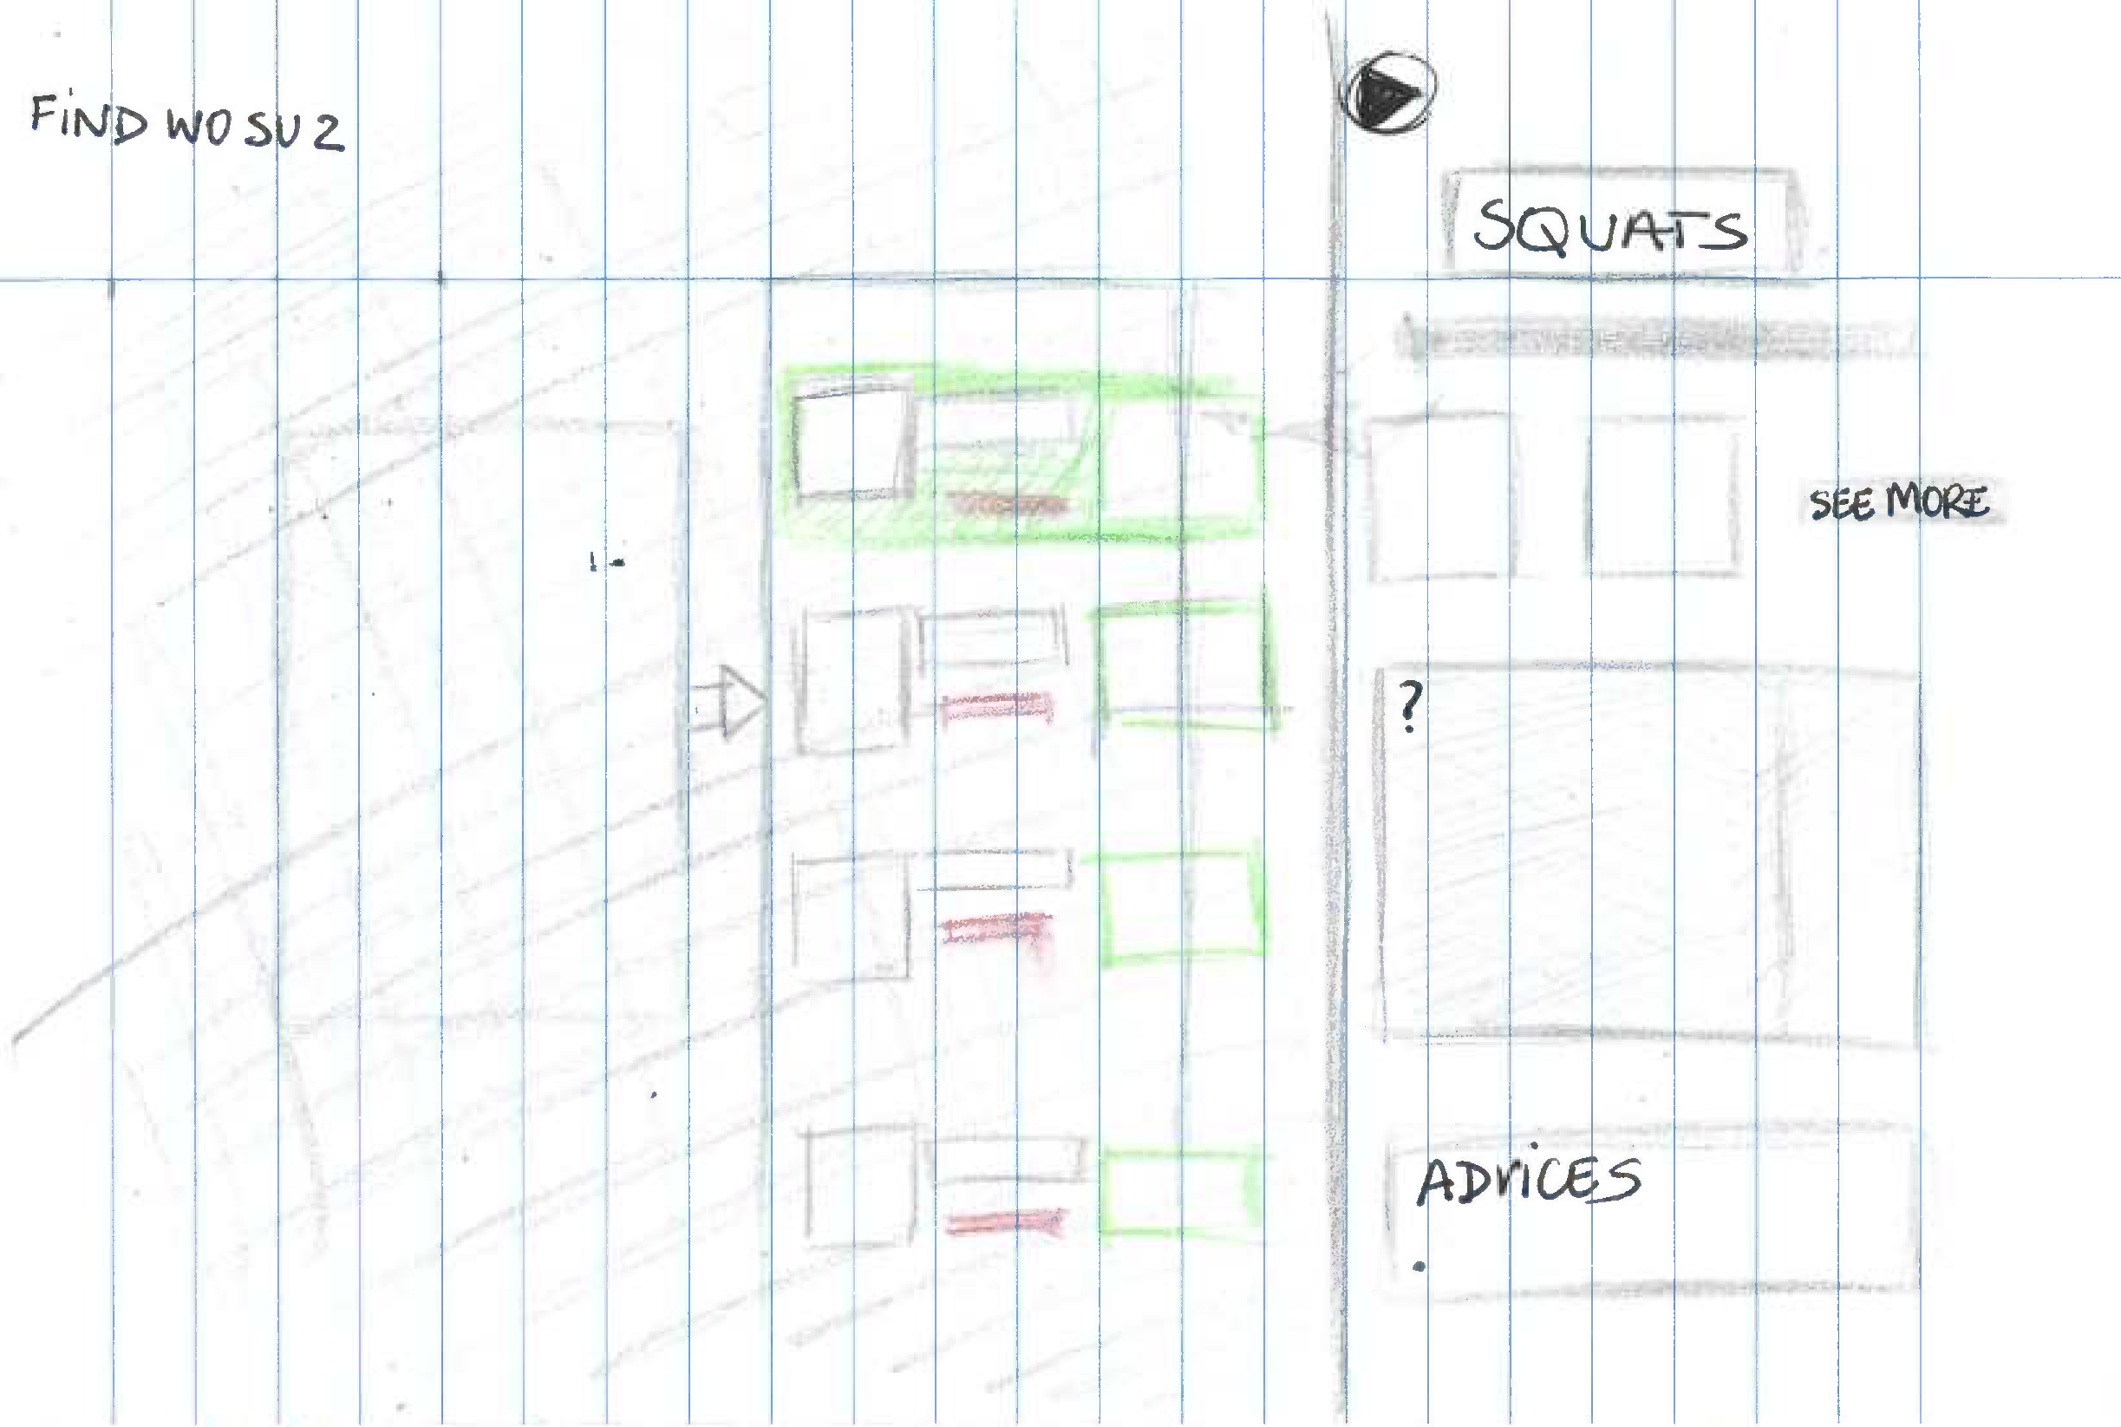
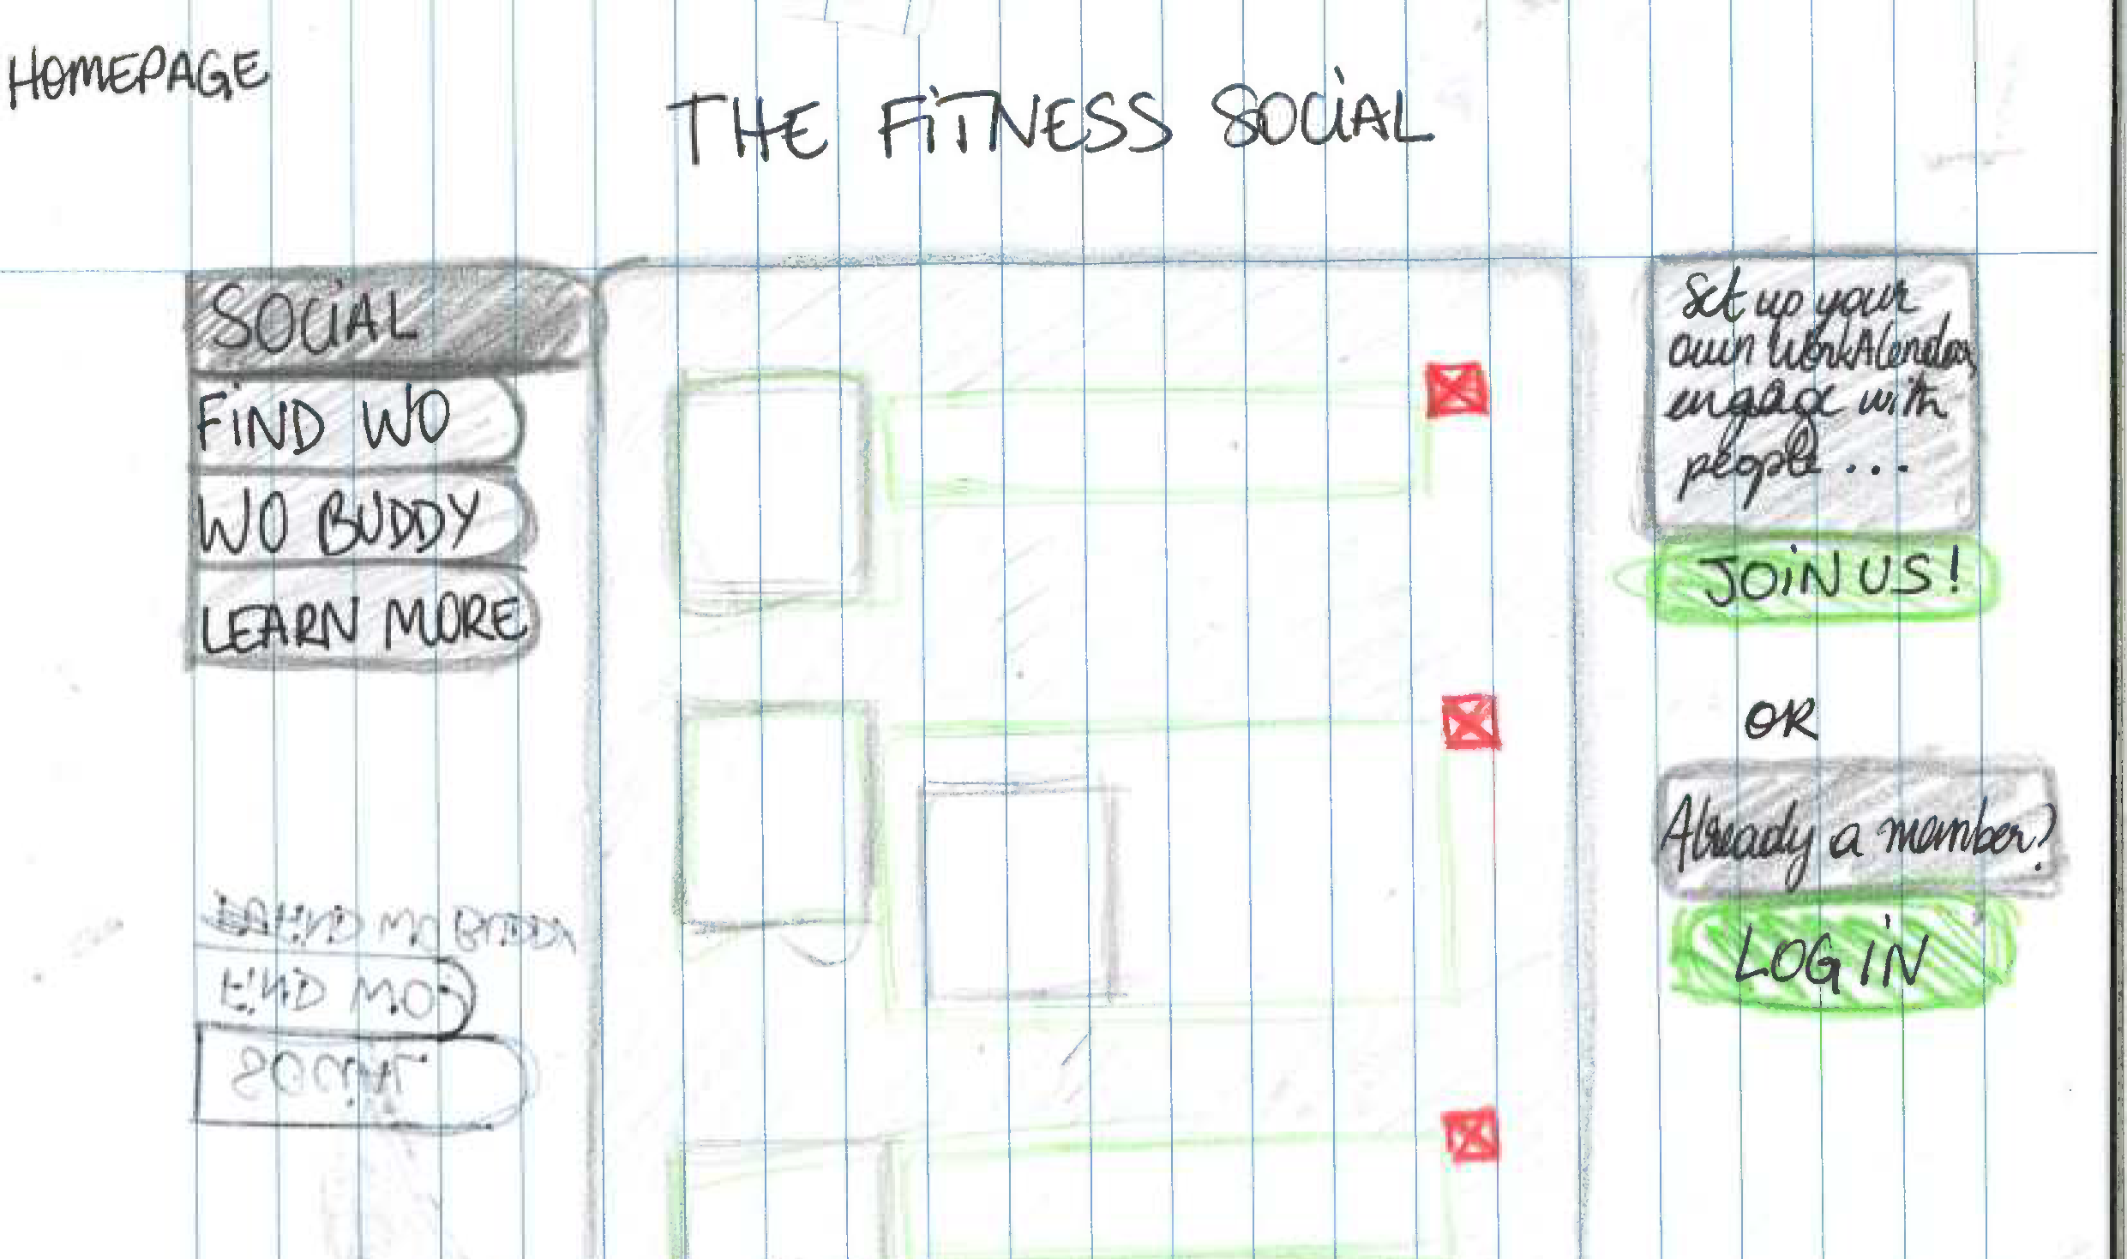

Slide 21
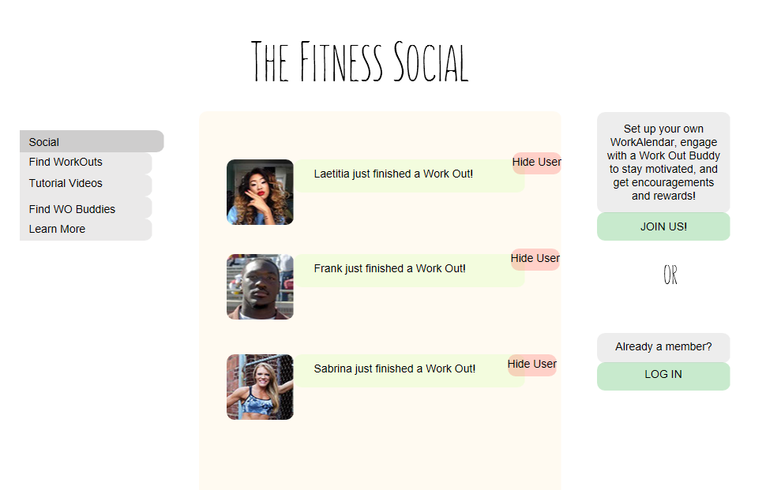
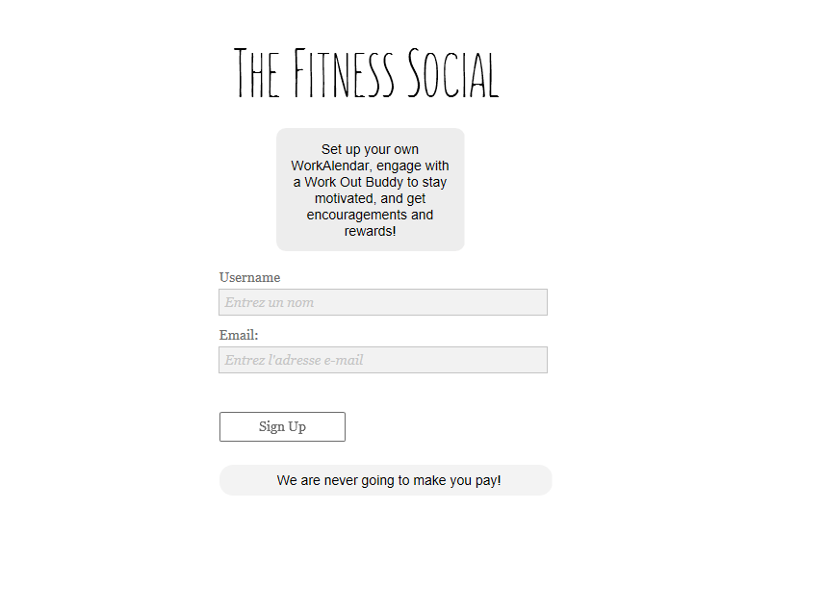
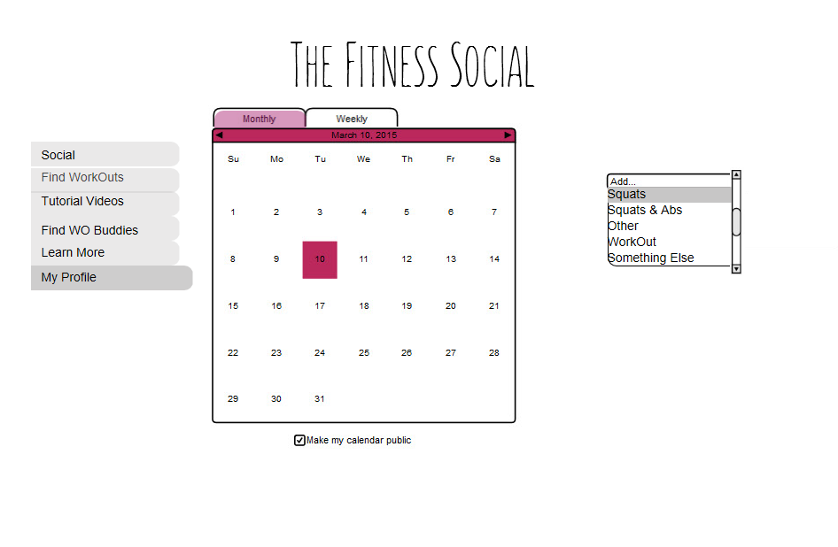

Slide 22
Current Wireframes
file:///C:/Users/Margot/Desktop/Margot/Classes/Designing%20UX/FitnessSocial/index.html

Slide 23

Part IV A Bit Of User-Testing
Where I had to talk, at length, to other people (ugh)

Slide 24
Functionalities
Validation that nothing is totally gross/Not understandable
Obvious things pointed out - see Log In Button
Fresh PoV
Different kinda people = Different kinda feedback (Interaction product student, Editing Student, Designer)

Slide 25
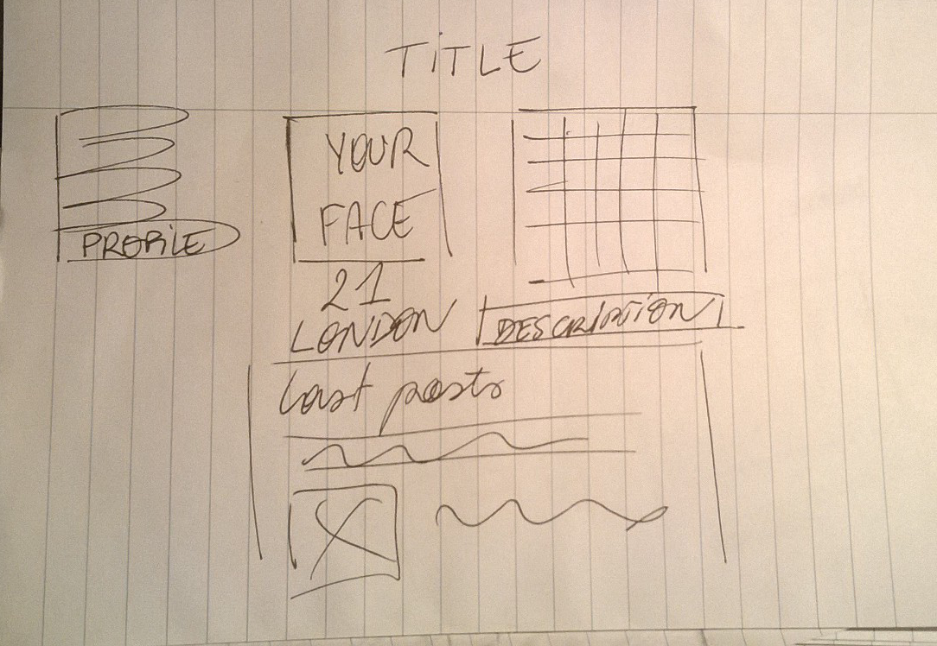
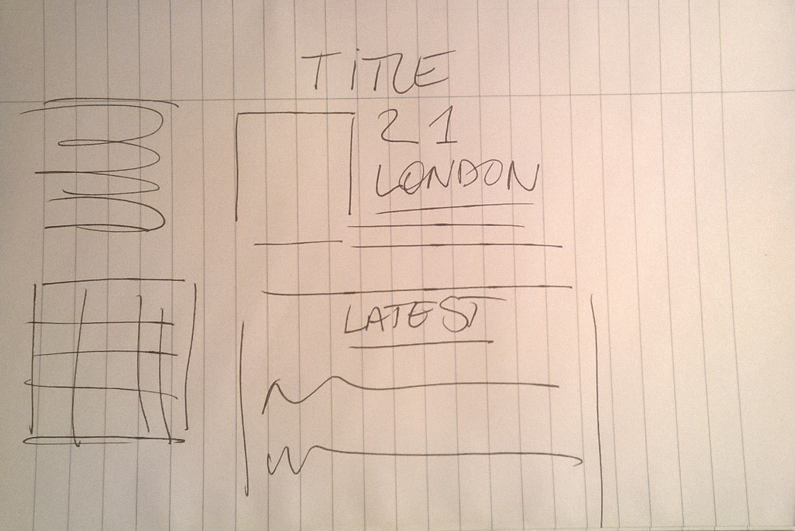
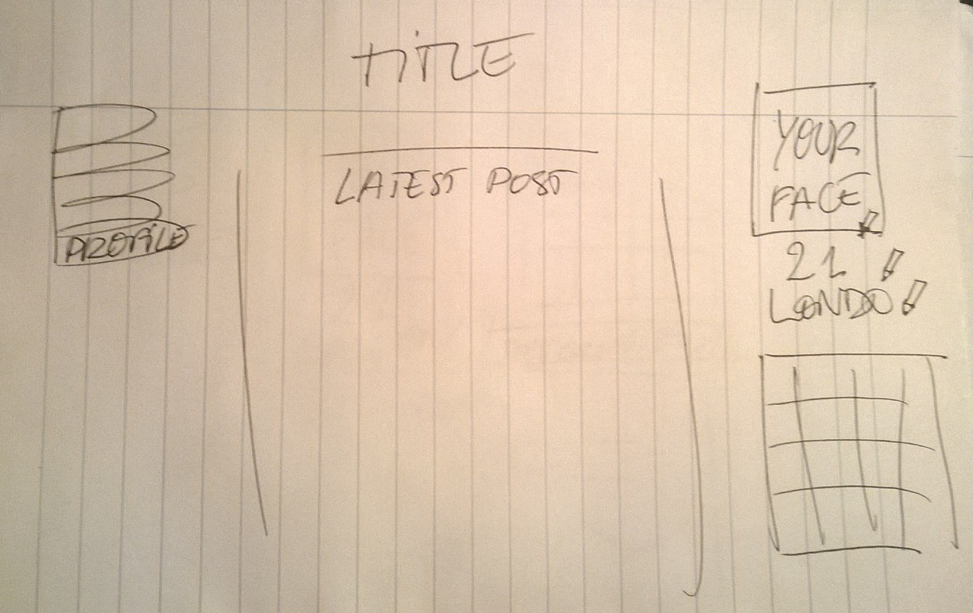
design
Worked with comparisons

Slide 26
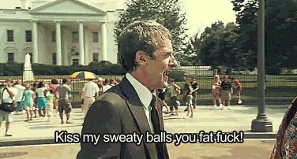
Part V A Bit Of Communication
Where I try to swear less to make my website appealing

Slide 27
CopyWriting
Relax feel – not taking itself seriously
Easy access – help throughout signing-up & first use – easily dismissible comments
Engagement: - Email at signing up - Reminder to fill in profile (mention Buddy up) - Weekly/Biweekly letter, with calendar reminders & such - Reminders at “peek times” – New Year, summer, etc.

Slide 28
Some User Stories
As a New User I want to be able to see a bit of content w/o signing up so that I know what I’m commiting to when I actually sign up
As a New User I want to be guided through the steps of setting up my profile so that I’m not lost like a poor potatoe right after signing up
As a regular user I want to access quickly the different sections so that I don’t have to click a fuckload at all time.

Slide 29

Part VI Bottom Line
We started from the bottom now we’re here

Slide 30
Goal: make the online sharing around fitness horizontal – people on the same level rather than following & reblogging
Solution: Network helping with both connections and personal achievements

Slide 31
And Now What?
Big work on graphic design – wooden plank, corkboard? ->Anyway, must feel personal
Better/believable prototype for portfolio
More user-testing even though ugggh

Slide 32

The one thing to remember
Questions?

